Slide 1
L4/5 Group 3
Physics Game
Zachari Cooper, Ryan Manthorp, Razvan Muresan Bardos, Bethany Cowle

Slide 2
The Brief
Create a 2D Adversarial physics game
Easy to learn, Hard to master
Chance and Skill

Slide 3
Target Audience
Young Adults
Male
Small Children
6-10
http://developers.magmic.com/demographic-breakdown-casual-mid-core-hard-core-mobile-gamers/

Slide 4
Gameplay -
What does
The player
Do?
Stacking
Balancing

Slide 5
Gameplay -
Adversarial
Character
Backgrounds
Playtesting

Slide 6
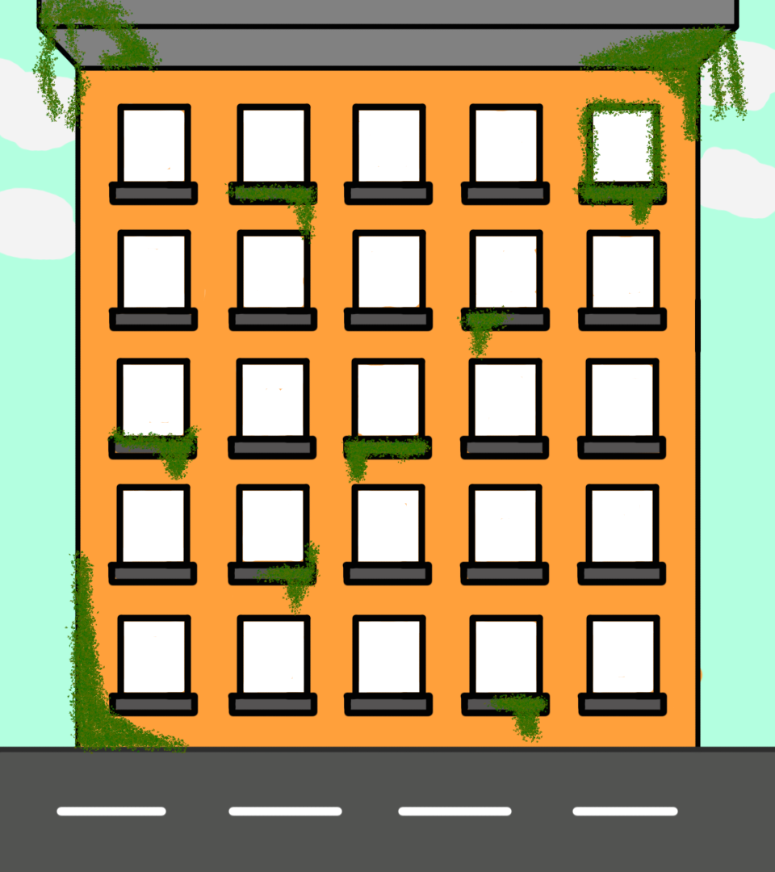
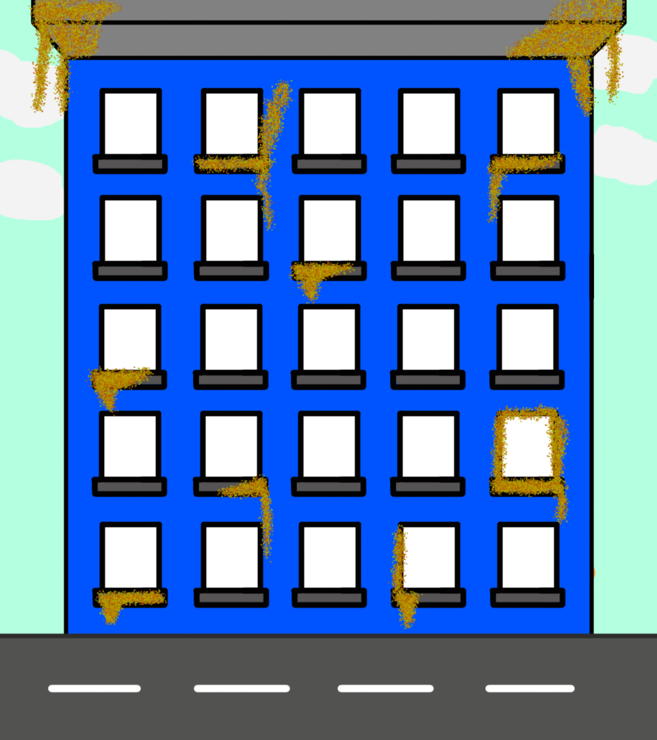
Where we see the final product -
Two player competition
Operational Gameplay
Playtesting

Slide 7
Hours worked -

Slide 8
Questions?

